Slide 1
MODEL-BASED PID BALL BALANCING SYSTEM
Leen Alsarayreh 20180869
Mohammed Dweik 20190113
Embedded Systems Lab

Slide 2
Introduction
1
Theory
2
4
Table of Contents
Simulink
Design Approach
3
5
Problems and Discussions
Conclusion
6

Slide 3
Introduction
The system should sense the position of the ball on a track by using the ultrasonic sensor.
A subtraction operation between the set point, and the value read by the ultrasonic sensor produces the error distance.
The error distance of the ball is then fed into the Proportional-Integral-Derivative (PID) Controller
The PID controller signals the servo motor that is placed under the track to move either up or down in order to balance the ball and bring it back to the center of the track.

Slide 4
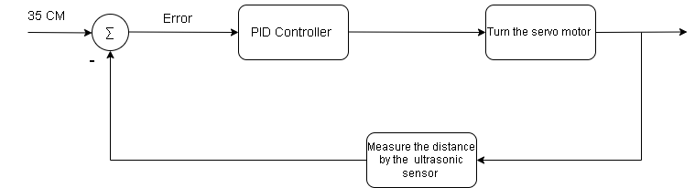
Theory
A PID controller is a device that regulates temperature, flow, pressure, speed, and other process variables in industrial control applications.
A PID controller use a control loop feedback mechanism to control process variables.

Slide 5
Components Used
Design Approach
One Ultrasonic sensor
One Servo Motor
Wires
One tennis ball
Arduino UNO
One Breadboard
Wooden sticks
Flexible joints
Wooden base

Slide 6
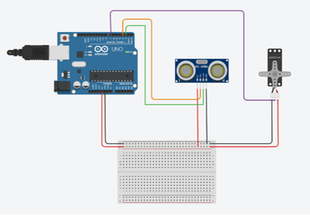
Design Approach
Hardware Connections
Ultrasonic sensor
Echo: Pin 3
Trigger: Pin 2
Servo motor
PWM: Pin 7

Slide 7
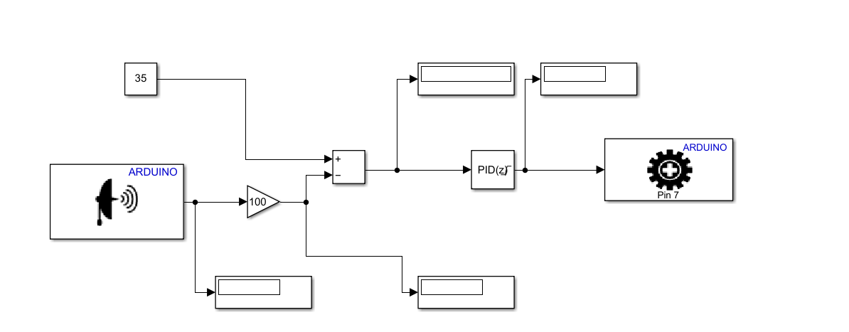
Simulink
PID Controller
P = 3.25
I = 0.705
D = 0
Servo Motor Output Range
Upper Limit = 120
Lower Limit = -120

Slide 8
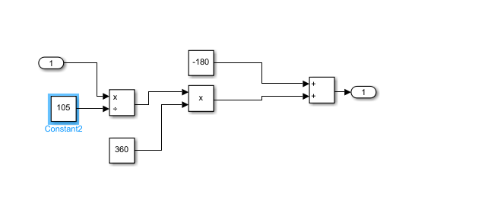
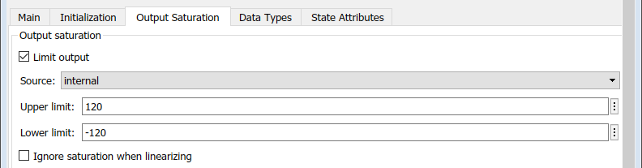
Problems and Discussions
Scaling the output of the PID controller
We measured the output when the ball was at the furthest point from the sensor and closest point from the sensor, then we did a scaling subsystem to scale the output.
We noticed that the PID controller itself can be limited to the range of output

Slide 9
Problems and Discussions
Tuning the values of P, I, and D
We followed the Ziegler–Nichols rule to achieve the system stability.
First, we tried with a small value of Kp and we kept increasing it until we reached a value of (3.25) for Kp, the response of the system became oscillatory.
Second, we began to tune the value of Ki. With the trial-and-error method, we got a good response when Ki was set to 0.705. The system balanced the ball in record time.
Unfortunately, neither Ziegler–Nichols rule nor the trial-and-error method gave us a proper value of Kd. We figured it's because noise can disrupt the feedback signals on the servo motor and causes it to give us an output that includes noise as values, and Kd is sensitive to noise.

Slide 10
Conclusion
To conclude, using the right hardware and software components enabled us to successfully build a ball balancing system, the Model-Based PID Ball Balancing System. Overall, the PID Ball Balancing System is effective for developing and demonstrating the related feedback control algorithm. Future work for this project can include adding a filter to the ultrasonic sensor to reduce noise.

